Slide 1
Chapter 4
Conducting
Marketing Research

Slide 2
What is Marketing Research?
Marketing research is the systematic design, collection, analysis, and reporting of data and findings relevant to a specific marketing situation facing the company.

Slide 3
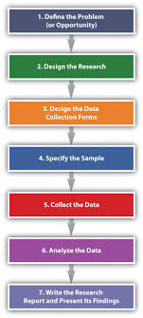
The Marketing Research Process

Slide 4
Step 1 : Define the Problem
Define the problem
° Problem should not be too broad or too narrow.
Specify decision alternatives
° State research objectives

Slide 5
Step 2: Develop the Research Plan...
Research instruments
  Questionnaires
  Qualitative Measures
  Technological Devices

Slide 6
Qualitative Measures
Word association
Asks subjects what words come to mind when they hear the
brand's name.
Visualization
Requires people to create a collage from magazine photo or
drawings to depict their perceptions.

Slide 7
Step 2: Develop the Research Plan...
Sampling Plan
Sampling unit:
  Who is to be surveyed?
Sample size:
How many people should be surveyed?
^{e} Sampling procedure:
How should the respondents be chosen?

Slide 8
Step 3: Collect the Informafion
The data collection phase of marketing research is generally the most expensive and the most prone to error.
Data collection methods are rapidly improving thanks to computers and telecommunications.

Slide 9
Step 4: Analyze the Informafion
The next to last step in the process is to extract findings by tabulating the data and developing frequency distributions.

Slide 10
Step 5: Present the findings
As the last step, the researcher present findings relevant to major marketing decisions facing management.

Slide 11
Step 6: Make the decision
Research findings provide additional information and help the managers in decision making process.
For more details (ref to the book)

